Slide 1

Lesson 14: JDBC, Flyway

Slide 2
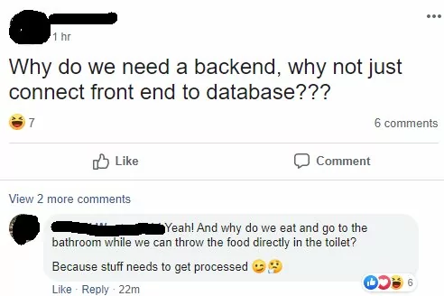
Lesson plan:
A little bit of everything :ъ
JDBC
JDBC Template
SQL statements
Flyway

Slide 3
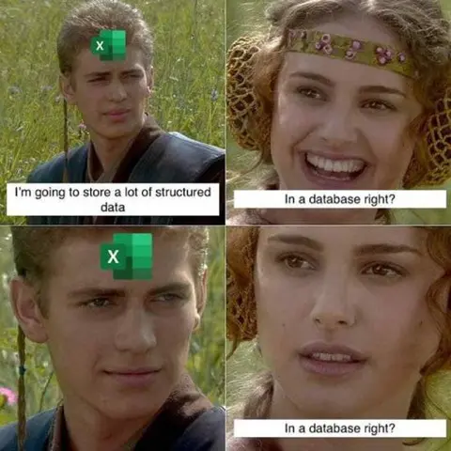
What is Database?
“Database - is a structured collection of data organized for efficient retrieval, management, and manipulation.”
“DBMS - Software that provides an interface for creating, managing, and interacting with databases, handling tasks such as data storage, retrieval, and maintenance.” @Someone

Slide 4
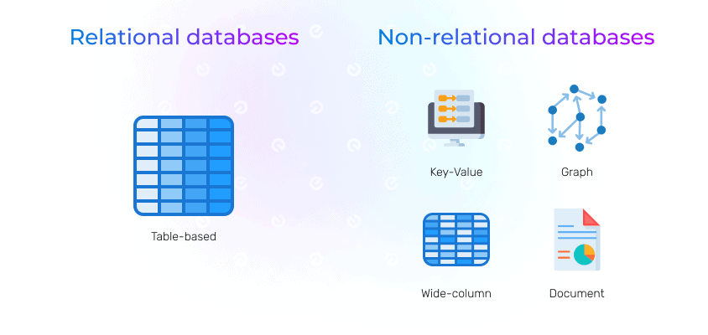
What is Database?

Slide 5
Relational vs Non-relational
Relational | Non-relational
In a relational database, data is organized in tables, where each table consists of rows and columns. The relationships between tables are established using keys (primary and foreign keys). This type of database follows the principles of the relational model, introduced by Edgar Codd. | Non-relational databases, often referred to as NoSQL databases, deviate from the traditional relational model. They are designed to handle various types of data and data models, providing more flexibility and scalability.
Key characteristics of relational databases include data integrity through the use of constraints, support for transactions, and a well-defined schema. | Non-Relational Databases: Support various data models, such as documents, key-value pairs, columns, or graphs, offering more flexibility in handling diverse data types.

Slide 6
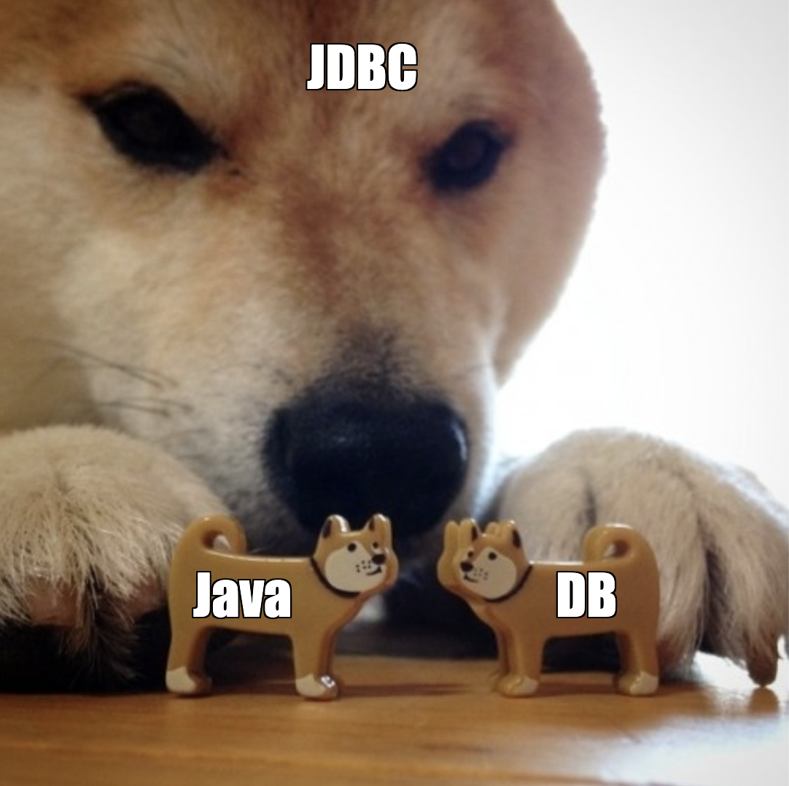
What is JDBC?
“JDBC is a Java-based API that allows Java applications to interact with relational databases. JDBC provides a standard interface for connecting to and executing SQL queries against databases. ”
@Someone

Slide 7
What is Datasource?
“The DataSource takes care of creating, managing, and providing connections to the application, including handling aspects like connection pooling, transaction management, and configuration. ”
@Someone

Slide 8
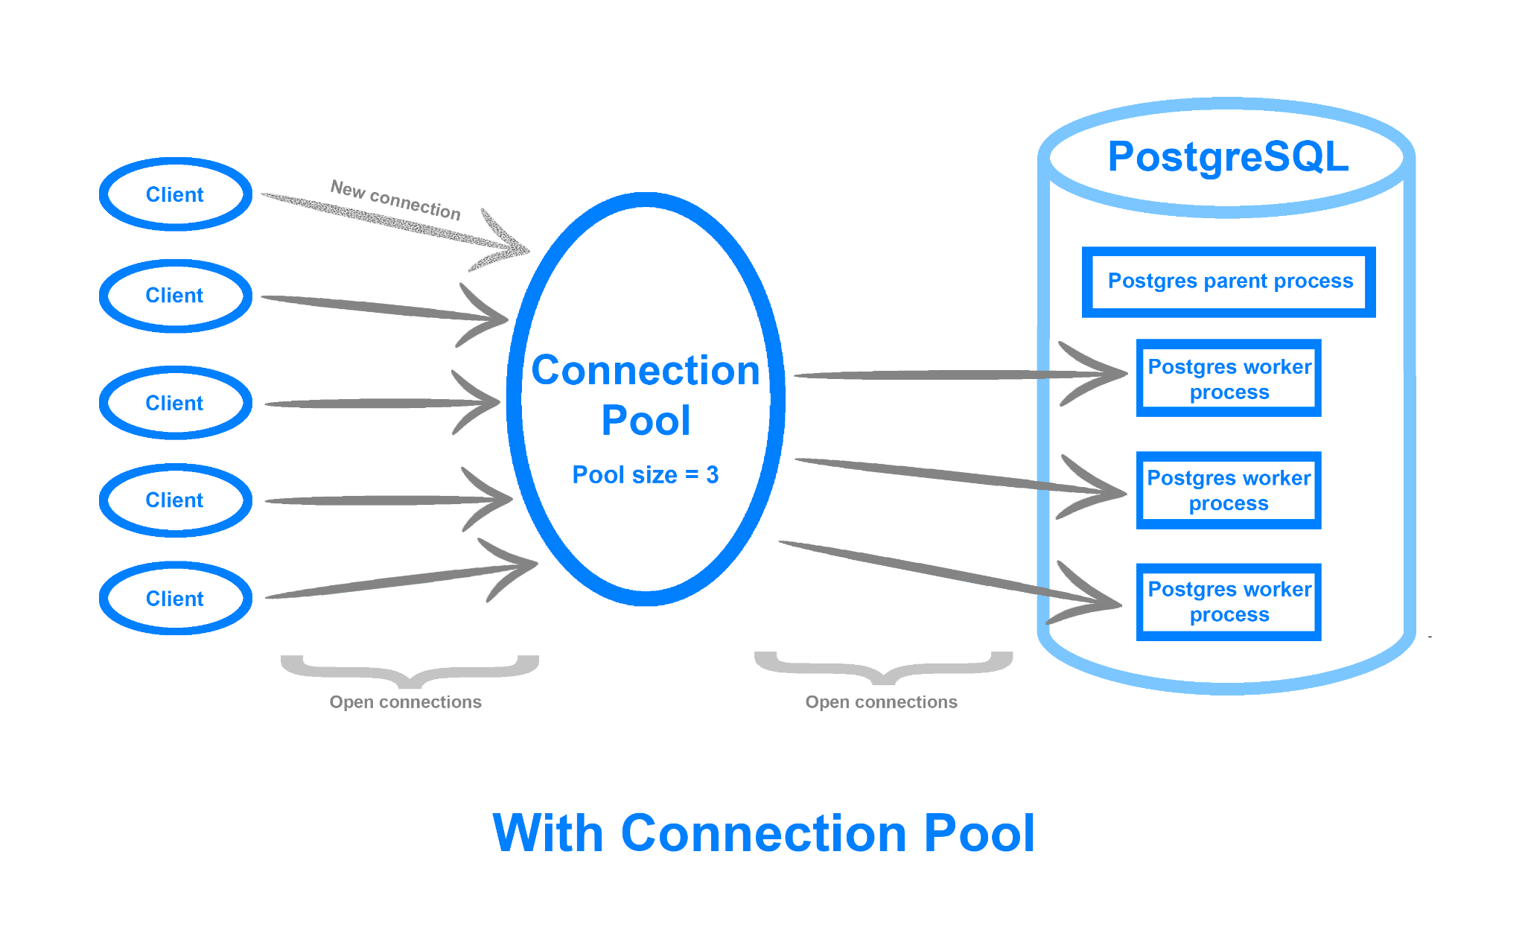

Slide 9
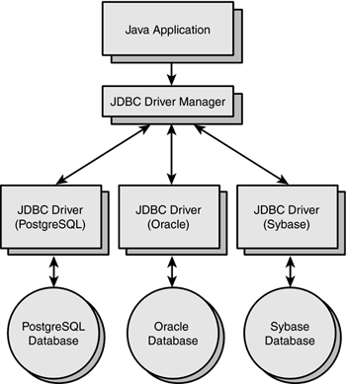
What is Jdbc Driver?
“The JDBC driver handles the communication between the Java application and the database server. It translates Java Database Connectivity (JDBC) calls made by the application into the corresponding database-specific calls.
Also it handles the low-level details of connection establishment, while the DataSource manages the higher-level aspects of connection pooling, configuration, and transaction coordination.”

Slide 10
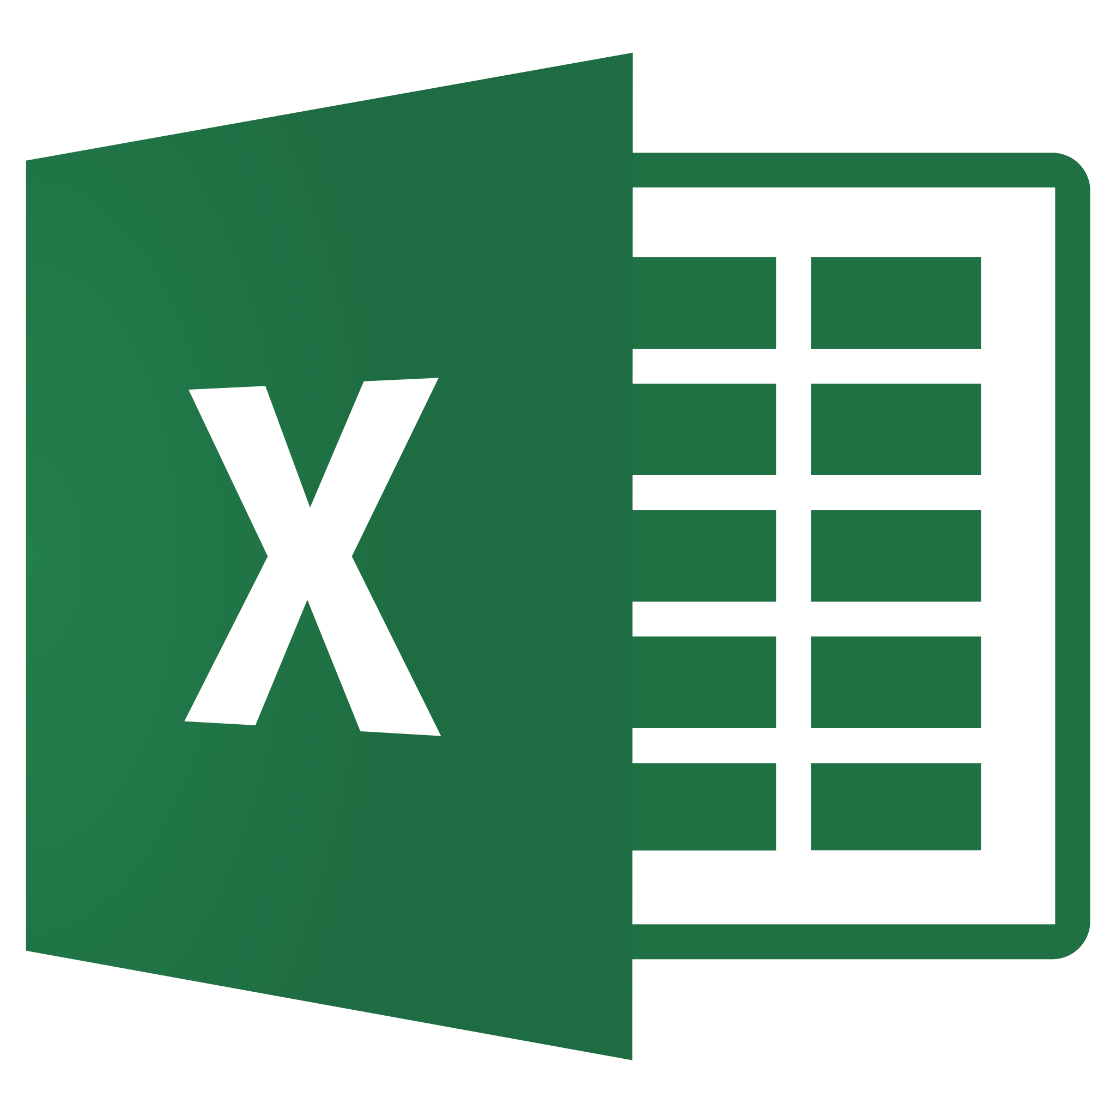

is a real database?
EXCEL

Slide 11
Spring JdbcTemplate. Who does what?
Action | Spring | You
Define connection parameters |  | X
Open the connection | X
Specify the SQL statement |  | X
Provide SQL statement parameters |  | X
Prepare and execute statement | X
Handle transactions | X
Close connection, statement and result set | X

Slide 12
Database connection example
@Configuration
public class DatabaseConfiguration {
@Bean
public DataSource datasource(@Value("${spring.datasource.url}") String jdbcUrl,
@Value("${spring.datasource.username}") String username,
@Value("${spring.datasource.password}") String password,
@Value("${spring.datasource.driver-class-name}") String driverClassName) {
HikariDataSource dataSource = new HikariDataSource();
dataSource.setJdbcUrl(jdbcUrl);
dataSource.setUsername(username);
dataSource.setPassword(password);
dataSource.setDriverClassName(driverClassName);
return dataSource;
}
@Bean
public NamedParameterJdbcTemplate namedParameterJdbcTemplate(DataSource dataSource) {
return new NamedParameterJdbcTemplate(dataSource);
} }

Slide 13

IT'S PRACTICE TIME!!!!!
Look what they need to mimic a fraction of my power!

Slide 14
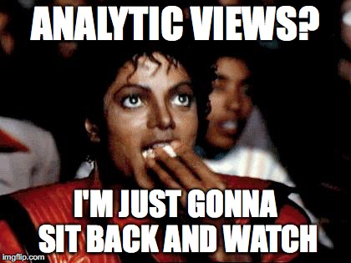
Virtual tables aka Views
“In SQL, a view is a virtual table based on the result-set of an SQL statement. ”
@w3schools.com
Data Abstraction - create a simplified and tailored representation of the data.
Complex Query Encapsulation
Join Simplification - provide a more convenient interface for querying

Slide 15
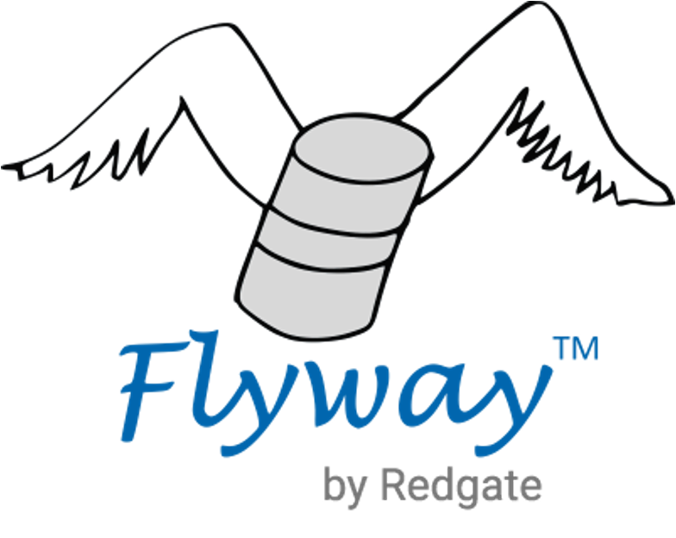
Flyway
“Flyway is an open-source database migration tool that simplifies version control and management of database schema changes in software development. ”
@Someone

Slide 16
Flyway main points
Database changes are called migrations.
Migrations can be written in SQL or Java
Migrations can ve Versioned or Repeatable.
Flyway automatically discovers migrations on the filesystem and on the Java classpath.
To keep track of which migrations have already been applied when and by whom, Flyway adds a schema history table - schema_version (depends on Flyway version)

Slide 17
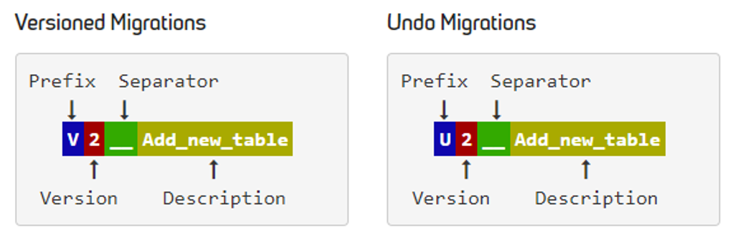
Versioned migration naming convention
V20210206101010__create_students_table
Applied in version order exactly once and can be undone

Slide 18
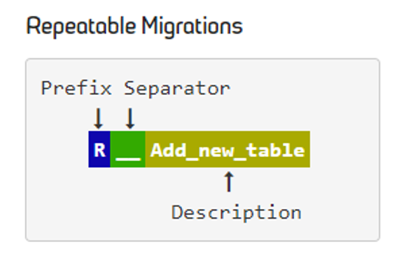
Versioned migration naming convention
R__fix_invalid_data
Main points:
Applied every time their checksum changes.
Always applied last, after versioned migrations have been executed.
Applied in the order of their description.

Slide 19
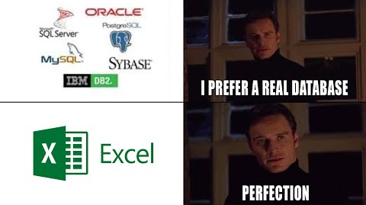

Slide 20

Homework
1.Application Database Configuration:
The application should dynamically switch between different databases based on the selected profile:
Development
Production
User Encoding History Management:
2.Implement a system to save user encoding history to the database:
Move history and audit logic to the database.
Save all encoding operations in the history with the 'active' user ID, who triggered that operation.
The active user ID should be passed in the application.properties. This user ID must exist in the database for the application to use it.
If your system supports decoding, add operation selection to application.properties.

Slide 21
Homework
3.Database Schema Population using Flyway:
Create the Users table (userId, name, email).
"Register" a new user in the system.
Create the History table (all necessary fields and userId).
4.Implement the ability to fetch history:
By the used encoding mechanism (Caesar, Vigenere, etc.).
By date:
In a specific time range (from, to).
In a specific time range with only one field specified (only from, only to). Should be done in one method.
Grouped by codec type (Caesar, Vigenere, etc.) and operation (Encode, Decode).
All with pagination (pageNumber, Offset).
All with pagination and UserID.

Slide 22
Homework
5.Create views for:
MonthlyEncodingStats: Create a view that aggregates encoding statistics on a monthly basis (by month, codec, status, count).
DailyEncodingStats: Create a view that aggregates encoding statistics on a daily basis (by day, codec, status, count).
FailedEncodings: Implement a view that displays encoding attempts that failed.

Slide 23

Questions & Answers

Slide 24
Thanks!
Find us in Slack:
@Bohdan Cherniak
@Vladyslav Nikolenko
@Volodymyr Vedula

